Slide 1

RS-INS-GLB-R-000463-V007 IICRA RSR
Derek Ding
Sr Director
Financial Services Methodologies
June 06, 2019
Copyright © 2016 by S&P Global. All rights reserved.
Last update – 5/6/2019

Slide 2
Agenda
Executive Summary
Relevant Criteria Articles
Key Model Development Information
Key Model Deployment Information
Access & Version Controls
Model Assumptions
Limitations/Restrictions on Business Use of Model
Material Changes
Testing
Back-testing
Model Training
Completed/Outstanding MVG Findings And Recommendations
Screenshot of Model Documentation listing from MDTS
Model Retirement Request

Slide 3
1. Executive Summary:
Model Name & ID:RS-INS-GLB-R-000463-V007 IICRA RSR
Covered Model Type: Rating model
Purpose of the Model: This model is used to determine and document IICRAs (Insurance Industry and Country Risk Assessments ) , which are a step in the analytical process for rating insurance companies. Although the model does not produce a rating outcome, it facilitates the derivation of, and rating summary record-keeping for, IICRA assessments that feed into the derivation of the business risk profile for an insurance company. The model produces final IICRA score based on the corresponding country risk and industry risk profile. The model produces final IICRA score ranging from 1(strongest – very low risk) to 6 (weakest – very high risk)
Region: Global
Business: Insurance
Model cross reference to other models: N/A
Actual or expected usage: This model will be used to conduct industry country risk assessments for insurance companies.
Time frame during which model is expected to remain valid: The Model is expected to remain valid until there are changes requiring a new version or changes to the applicable criteria.
Squad: Model working group:
Developer: Mario Chakar, Derek Ding
Tester: Luke Tian
Squad Leader/Model Owner: Simon Marshall/Derek Ding
Model Coordinator/Approver: Simon Marshall

Slide 4
2. Relevant Criteria Articles:
 | Criteria ID (CUID) | Date Criteria Published | Criteria Title
1 | N/A | TBD | Insurers Rating Methodology
2
3
4
5

Slide 5
3. Development Information:
Lead Model Developer: Mario Chakar
Start/Completion Dates of Model Development: Nov 01, 2018 - Mar 01, 2019
Type & Source of Inputs:
Main inputs for deriving final IICRA score include:
• Country risk assessment;
• Industry risk assessment; and
• Adjustment, if applicable.
Additional inputs to assist the assessment of industry risk include:
• Profitability;
• Product risk;
• Barriers to entry;
• Market growth prospects; and
• Institutional framework.
Model performance measures:
Model testing report -parallel replica of the model, benchmarked replica output with original model output
Business testing
Criteria validation report
Date of model validation report (if any): 21-May-2019

Slide 6
4. Deployment Information:
Platform for model deployment: Excel
Lead Model Implementer: Divya Cheekati, Venu Komaragiri, Derek Ding
Date of Model Implementation Validation report: 21-May-2019

Slide 7
5. Access & Version Controls for Model Deployment:
Model is password protected.
The internal users access the model from the model repository.

Slide 8
6. Key Model Assumptions:
Description of Assumption | Criteria |  | Guidance |  | Ratings Committee or Analyst |  | Model Development
 | Concept | Value | Concept | Value | Concept | Value | Concept | Value
The model assumes that the final IICRA score is solely derived from assumptions relating to industry and country risk factors. | X |  |  |  |  | x
The model assumes that analytical judgement is applicable in cases where it is determined that the balance of industry and country risks materially understates or overstates the risks for the insurance sector of operating in a given country. In such cases, the IICRA score can be adjusted by one category. | x |  |  |  |  | x

Slide 9
6. Key Model Assumptions:
Description of Assumption | Assumption deployment in model
 | User Input | Embedded | Override Capability
The model assumes that the final IICRA score is solely derived from assumptions relating to industry and country risk factors. | x
The model assumes that analytical judgement is applicable in cases where it is determined that the balance of industry and country risks materially understates or overstates the risks for the insurance sector of operating in a given country. In such cases, the IICRA score can be adjusted by one category. | x

Slide 10
7. Limitations/Restrictions for the Model The model applies exclusively to the insurance industry. It should only be used to derive the IICRAs for a designated combination of industry and country risks.

Slide 11
8. Material Changes from Prior Model
Effective June 2019, we incorporated the following changes to the model:
updated and simplified the IICRA calculation to be consistent with the latest insurer rating methodology criteria;
We do not anticipate that these changes will have an impact on any of our current ratings.

Slide 12
9. Testing:
Model tester built an independent implementation of the model in MATLAB based on the model specification documents. Approximately 10,000 Random tests created by the tester. The outputs generated by both models were compared and all the results matched with no issues found.
The practice conducted business testing of approximately 100 test cases on the model with no issues found.

Slide 13
10. Back-testing:
This Covered Model solely implements analytical considerations that are set out in Criteria and/or any associated Guidance document(s). The Criteria back-testing is used to confirm acceptable model performance since this Covered Model embodies the relevant Criteria and corresponding Guidance document(s)”.
MVG reviewed testing results from the Criteria Pre‐RFC Validation conducted in November2018 for the proposed Criteria “Request For Comment: Insurers Rating Methodology”. The review mainly focuses on Section 7 “Impact Analysis, Back‐ and Stress Testing” and Appendices V, VI, and VII in the Criteria Validation Report (CVR) “Criteria Pre‐RFC Validation Report” (Project ID: CP‐203).
Three testing exercises were performed in the Criteria Pre‐RFC Validation to verify that the proposed Criteria produces expected results without unintended consequences: impact analysis, back‐testing and stress testing. The impact analysis used data from the RSR database to estimate the impact of using the proposed Criteria on existing Stand‐Alone Credit Profile (SACP), given SACP is the key Criteria output to derive Issuer Credit Rating (ICR). By simulating the SACP for 496 test cases and carefully reviewing the potential changes, Criteria Validation Group (CVG) found the impact testing results to be consistent with the Criteria’s intend. A qualitative back‐testing was also performed focusing on exceptions to the Credit Stability Criteria (ECS) experienced between January 2008 and March 2018. For those exceptions, CVG identified the root causes, simulated the potential rating changes under the proposed Criteria, and evaluated whether the causes were addressed under the proposed framework outlined in the Criteria. Based on a detailed analysis of the testing results, CVG agreed that the proposed Criteria indicates an improvement in terms of timeliness and direction of transactions. To test the sensitivity of ratings to changes in key rating factors under proposed Criteria, stress testing were conducted under four scenarios.
CVG concluded in the CVR that the aforementioned testing exercises are sufficient for pre‐RFC purpose and testing results are supportive of the proposed Criteria. Since the Model embodies new IICRA framework specified in the proposed Criteria and the Criteria has been sufficiently tested, MVG concluded that the testing results can support the theoretical construction and key assumptions of the Model.

Slide 14
11. Model Training
Is this a new Model or material change to a Model? Material change
Is training required ? No (handbook and related criteria are available for new hires)
Has training been completed? N/A
Date of completed Model training – N/A

Slide 15
12. Outstanding MVG Findings And Recommendations:
None. All MVG findings have been resolved as per the Management Action Plan submitted.

Slide 16
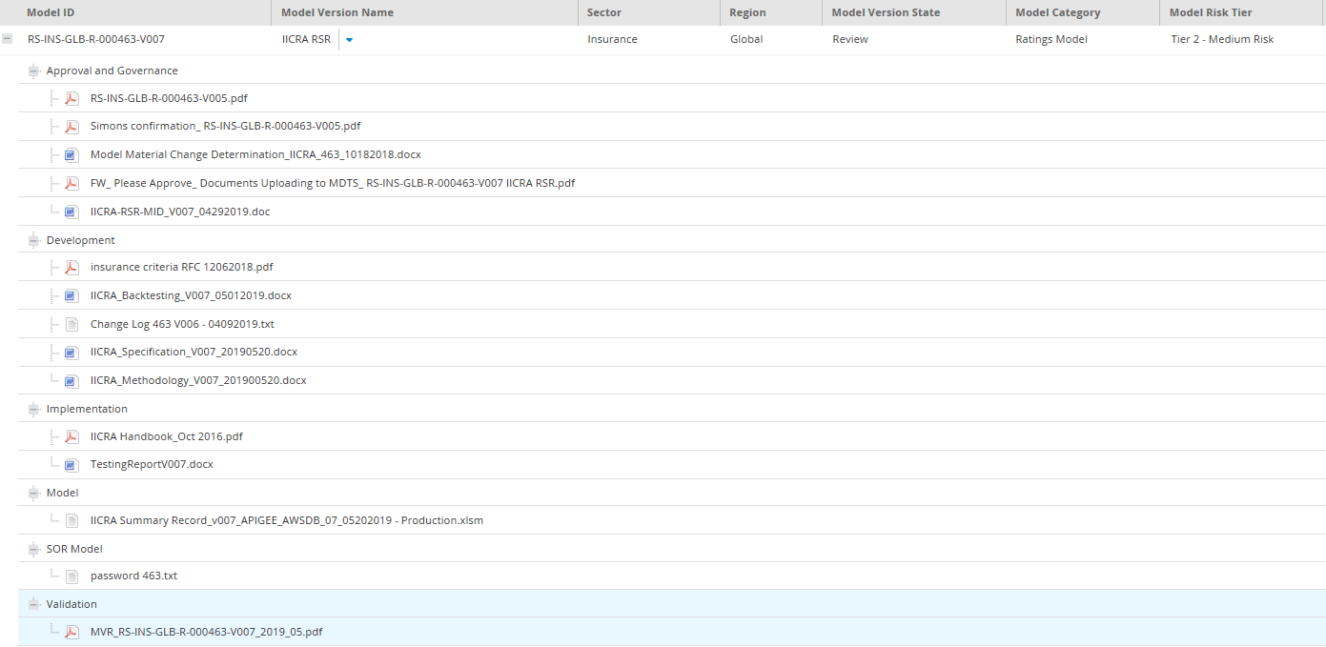
13. List of Model Documentation: screenshot of Model Repository (MDTS)

Slide 17
14. Model Retirement Request
Reason for Retirement Request: Model RS-INS-GLB-R-000463-V007 fully supersedes the prior versions. We thus request that RS-INS-GLB-R-000463-V006 be retired on June 28th when V007 is scheduled to be put into Business Use.
This model is used in Mexico.

Slide 18
Thank You INTERNAL COMMUNICATION ONLY / NOT FOR EXTERNAL DISTRIBUTION This document is the property of S&P Global Ratings. It contains proprietary and confidential information and is for internal use only by S&P Global Ratings employees. This document shall not be shown or provided to anyone other than S&P Global Ratings employees

